Slide 1
Geospatial Visualization
Using a tiling backend

Slide 2
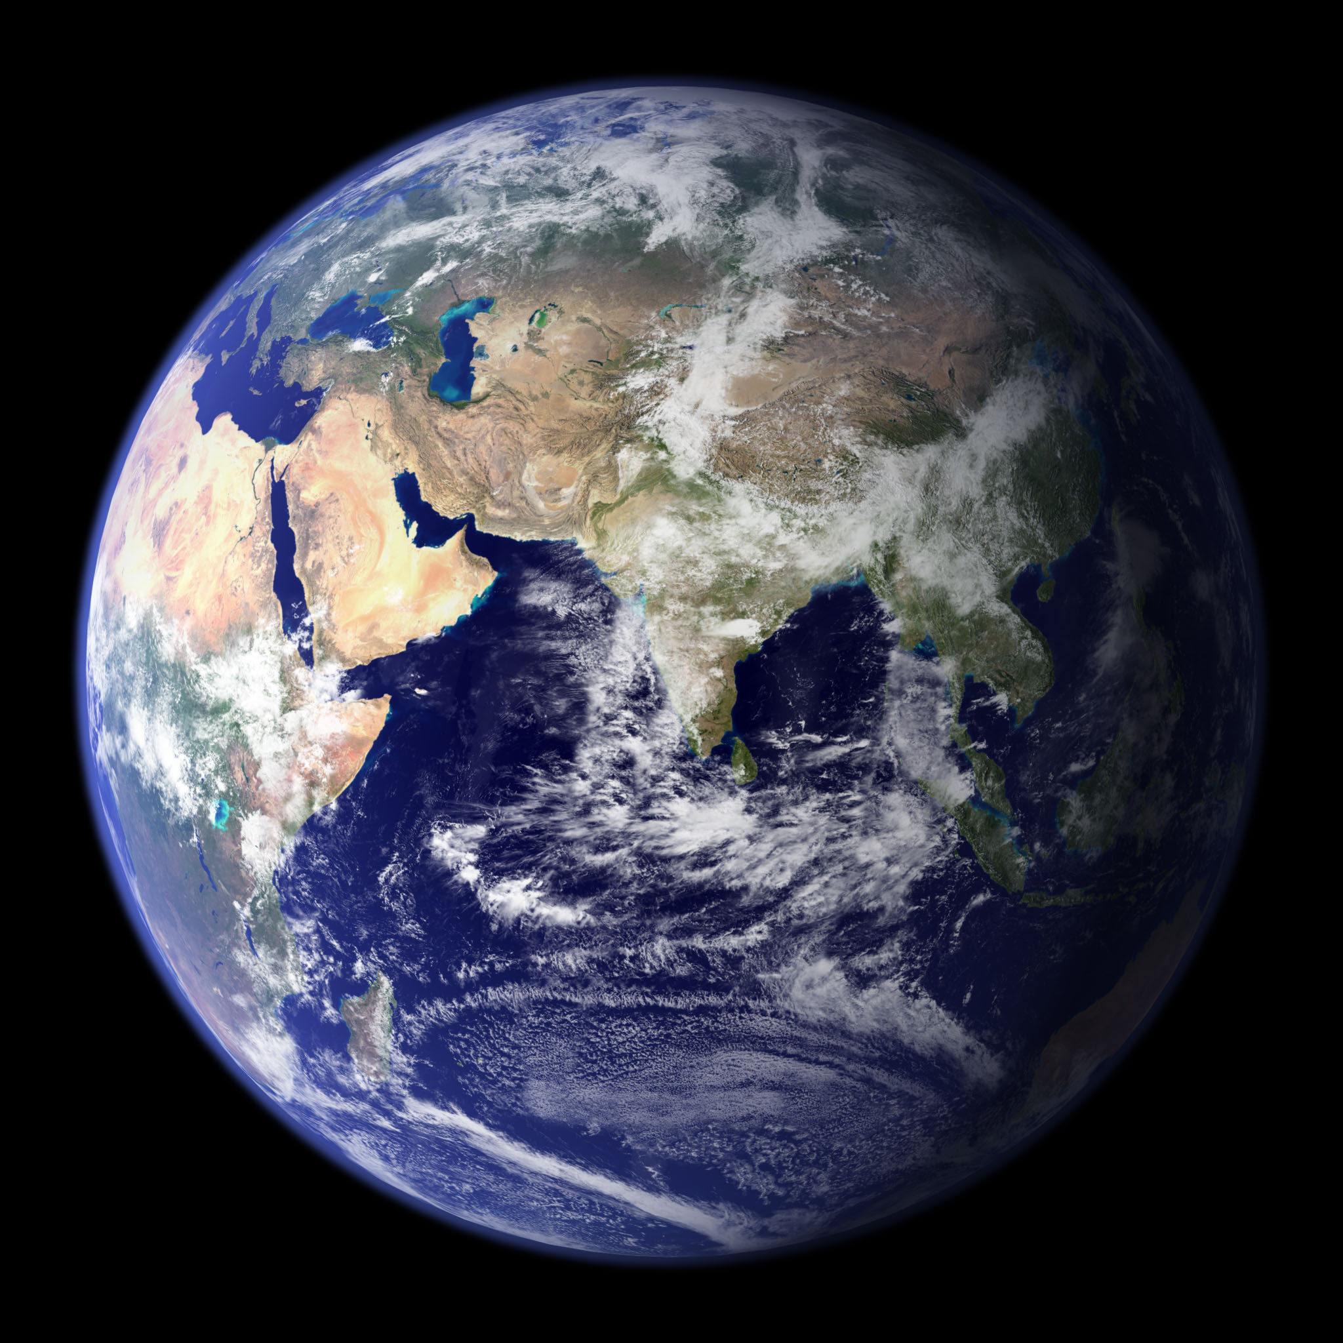

Slide 3
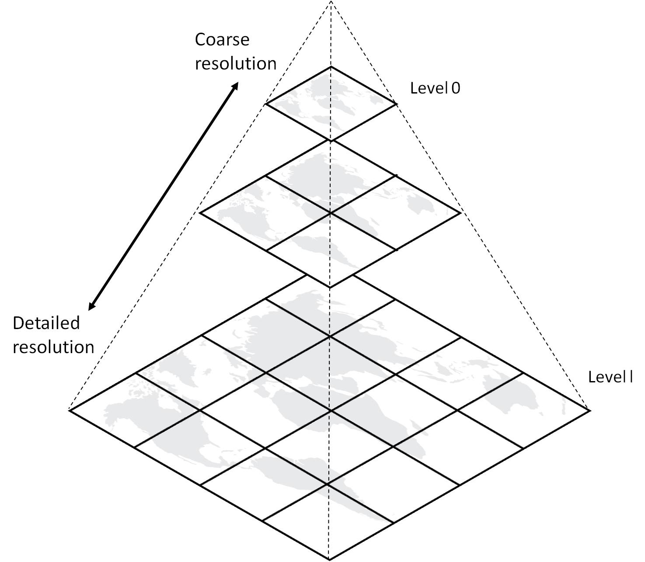

Slide 4





http://{s}.tile.osm.org/{z}/{x}/{y}.png
https://api.tiles.mapbox.com/v4/{id}/{z}/{x}/{y}.png
or
or

